Slide 1
Employee Travel Management Application

Slide 2

Team Members
1.Chitteti Sushmitha
2.Durgesh Banote
3.Soumendra Mallick
4.Saura Chanda
5.Chaitanya Deshmukh
6.Komal Karale
7.Parul Kumbhalkar
8.Shubhangi Khare
9.Tushar Thakre
10.Sourabh Gupta
11.Soumyadeep Sen
12.Sachi Jain
13.Akshay Jain

Slide 3
Project Details
Topic:Employee Travel Management Application
Users: 1.Admin
2.Employee
3.Manager
4.Travel Agent
Technology:WPF 4.5,ADO.Net
Back End:SQL Server 2012+

Slide 4
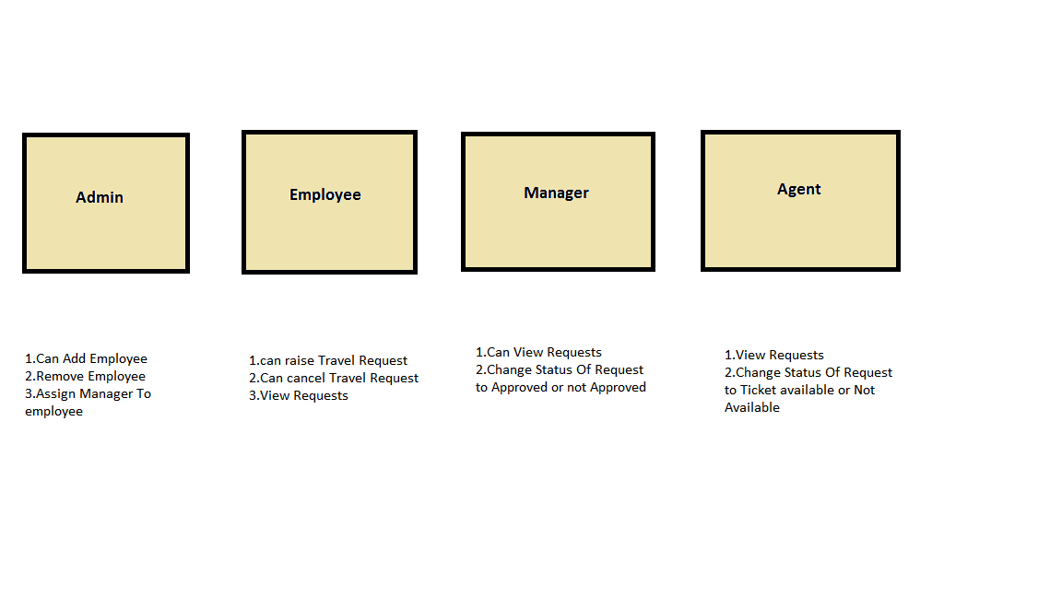
Functionality Of Project

Slide 5
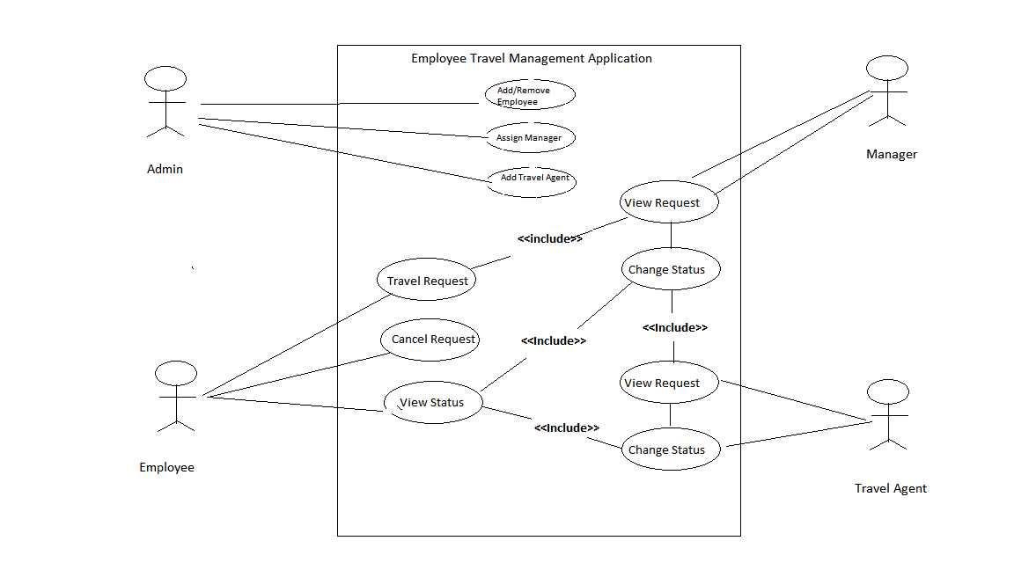
Use Case Diagram

Slide 6
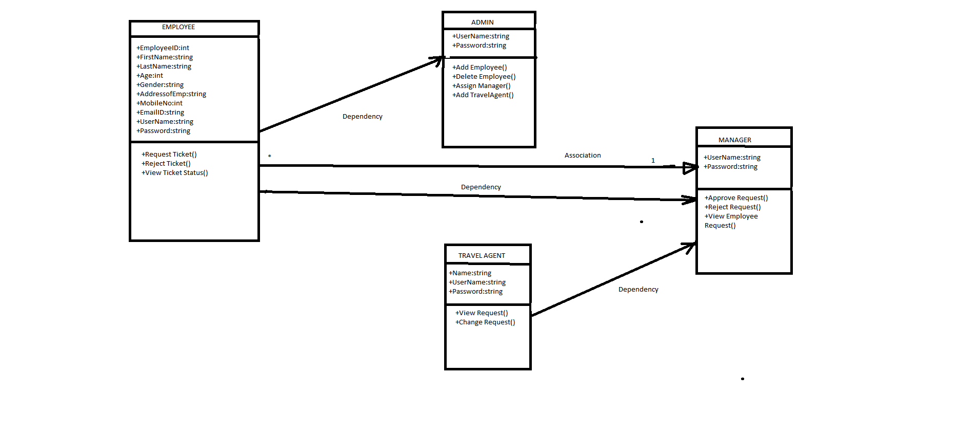
Class Diagram

Slide 7
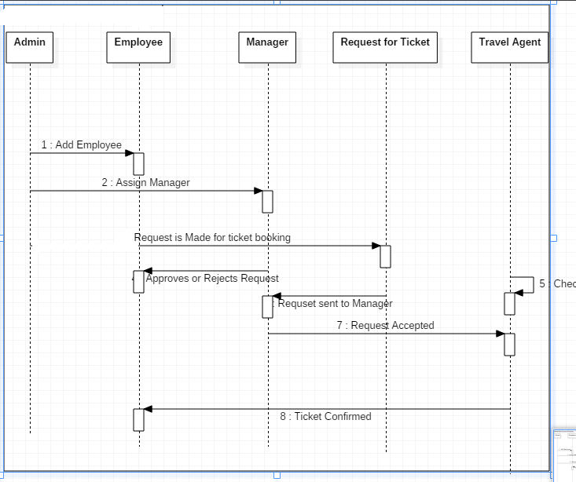
Sequence/Activity Diagram

Slide 8
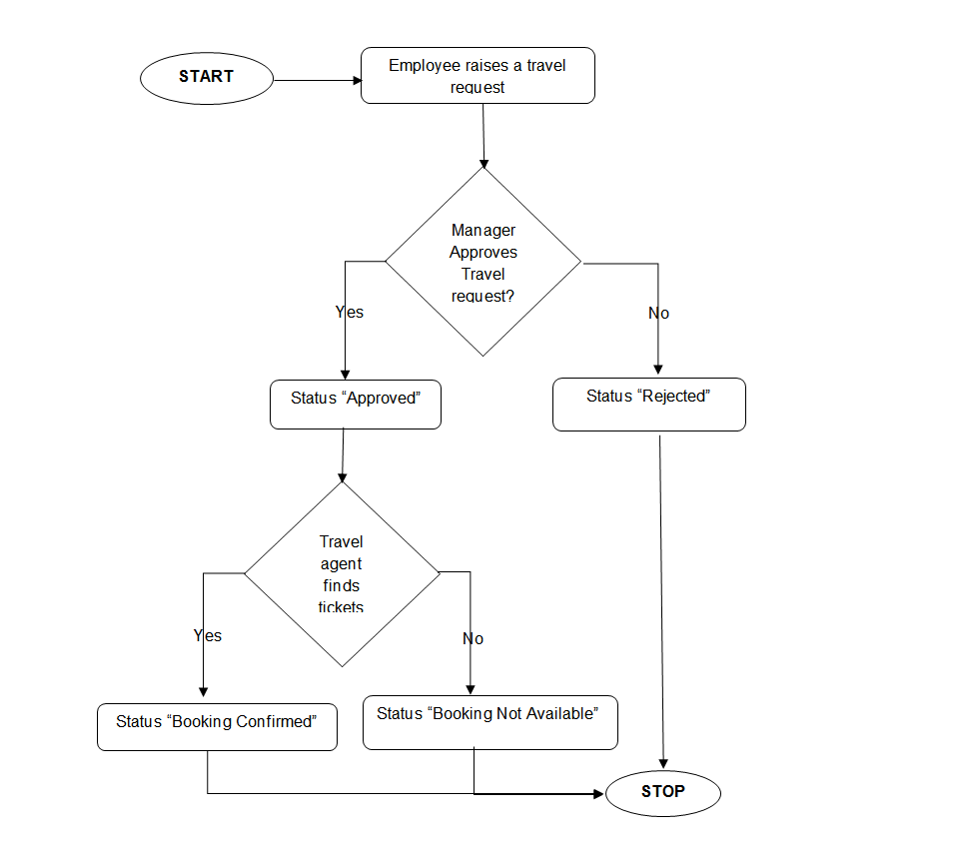
Flow Chart

Slide 9
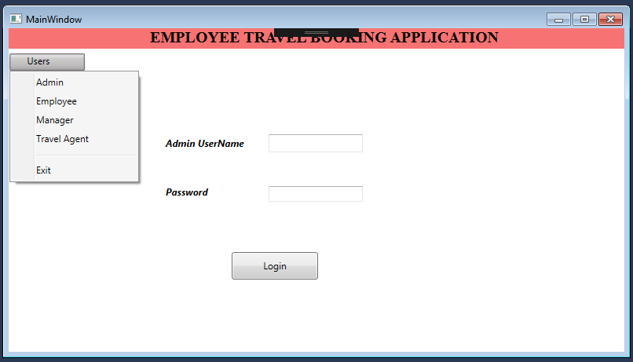
Screen shots

Slide 10
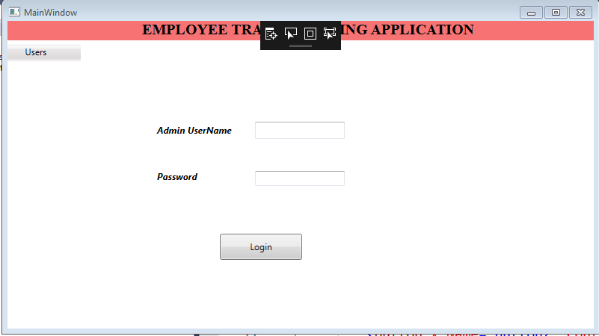
Screen shots

Slide 11
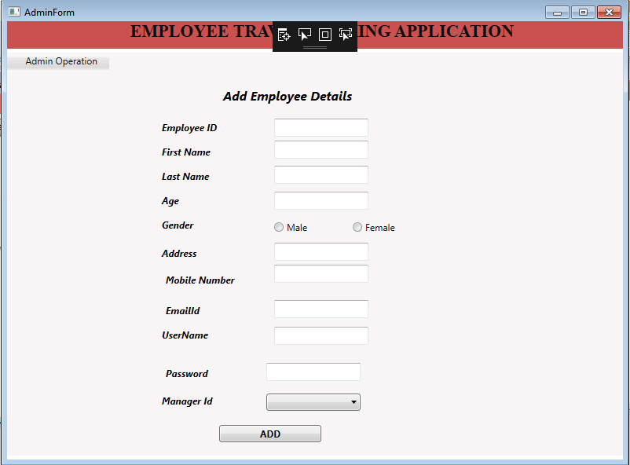
Screen shots

Slide 12
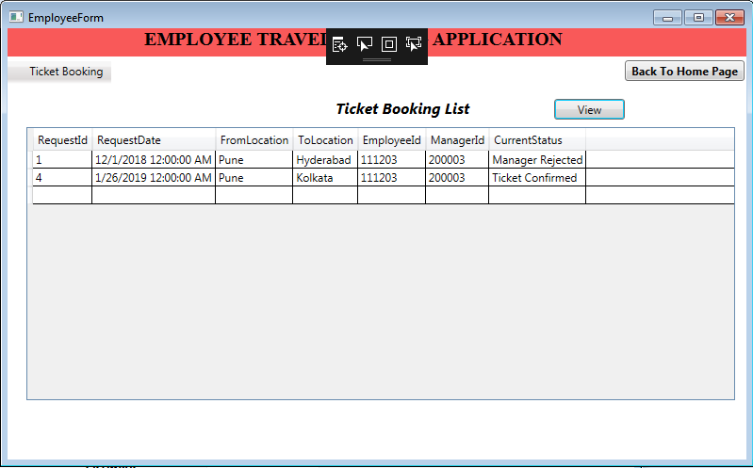
Screen shots

Slide 13
Future Enhancements
1.More Users Can Be Added.
2.Can Be Implemented In WebForms.
3.We can Use Cloud For Data Storage.
4.Can Be Created In Mvc And WPF Service Application.
5.More Functionality Can be Added.

Slide 14
Thanks

